Slide 1
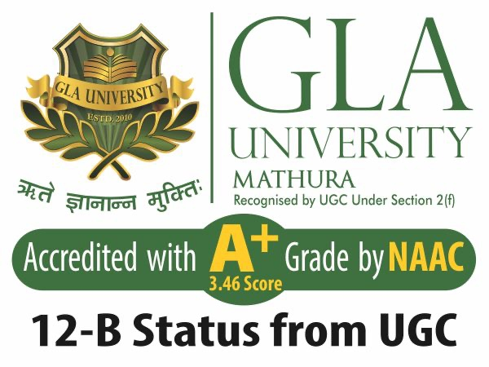
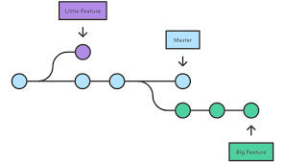
Agile Software Development
Topic: Version Control Systems
Dr. Nikhil Govil
Associate Professor, Program Coordinator – B.Tech. (CSE), Dept. of CEA

Slide 2

Topics to be covered
Version Control Systems
Categories of VCS
Local Version Control Systems
Centralized Version Control Systems
Distributed Version Control Systems

Slide 3
Version Control Systems (VCS)
Version control systems are a category of software tools that help a software team manage changes to source code over time.
Version control is also known as Revision Control or Source Control.
Version control software keeps track of every modification to the code in a special kind of database.

Slide 4
Version Control Systems (VCS)
If a mistake is made, developers can turn back the clock and compare earlier versions of the code to help fix the mistake while minimizing disruption to all team members.
Changes are usually identified by a number or letter code, termed the “revision number”, “revision level”, or simply “revision”.
Each revision is associated with a timestamp and the person making the change. Revisions can be compared, restored, and with some types of files, merged.

Slide 5
Categories of VCS
Version Control Systems (VCS) can be categorized as:
Local Version Control Systems,
2. Centralized Version Control Systems &
3. Distributed Version Control Systems.

Slide 6
Local Version Control Systems
Local VCS is an approach that the user keep its own file or saved the file by its own self, they manage their own file.
But it is hard to maintain the changes of the file.
We can just accidentally replace another file that actually we need.
Old programmer made their own database that kept all the changes to file under local version control system.

Slide 7
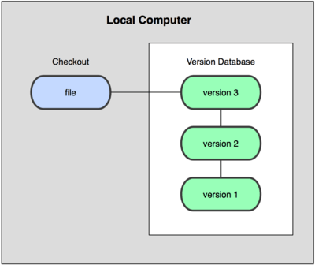
Local Version Control Systems

Slide 8
Centralized Version Control Systems
Centralized VCS as known as one of its application, subversion (SVN) or maybe other application Concurrent Versions System (CVS).
Centralized CVS is a way to track changes on project, but differently with local VCS, this way we save the snapshot of the application on the server, with history changes saved in the server.

Slide 9
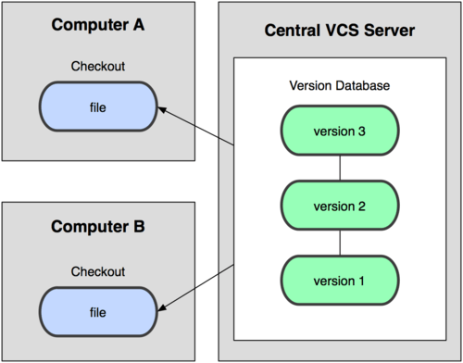
Centralized Version Control Systems

Slide 10
Distributed Version Control Systems
Distributed VCS as the inverse of the Centralized VCS, it gives all the management/traceable of the project in the developer/client side, not server side, you can checkout the branch without connecting to server, even you can commit changes, trace changes that you have made even without internet connection.
But you can push the changes whenever you have an internet connection (push is a process that you save the snapshot that you have made to the server (in Centralized VCS called commit), so whenever everybody else who want to get it, they can just login and get the project from the server without thinking about that VPN things).

Slide 11
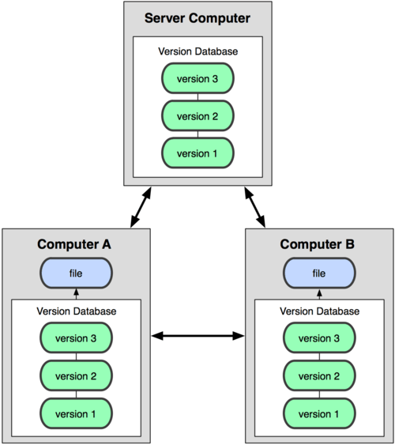
Distributed Version Control Systems

Slide 12
References
Ken Schawber & Mike Beedle, Agile Software Development with Scrum, Pearson, 2008.
Robert C. Martin, Agile Software Development, Principles, Patterns and Practices, Prentice Hall,2002.
Lisa Crispin & Janet Gregory, Agile Testing: A Practical Guide for Testers and Agile Teams, Addison Wesley, 2008.
Alistair Cockburn, Agile Software Development: The Cooperative Game, Addison Wesley, 2006.
https://medium.com/@kamilmasyhur/what-do-you-know-about-version-control-system-vcs-6a1e1922c970#:~:text=So%2C%20what%20is%20local%20version,file%20that%20actually%20we%20need/last accessed on 08/11/2024.

Slide 13


